Slide 1
An Introduction to Poetry
Terms and Types
9/3/19

Slide 2
Introduction to Poetry by Billy Collins
I ask them to take a poem and hold it up to the light like a color slide or press an ear against its hive. I say drop a mouse into a poem and watch him probe his way out, or walk inside the poem's room and feel the walls for a light switch. I want them to waterski across the surface of a poem waving at the author's name on the shore. But all they want to do is tie the poem to a chair with rope and torture a confession out of it. They begin beating it with a hose to find out what it really means.

Slide 3
What is Poetry?
The subject matter can vary dramatically!
Fixed or free form
  Fixed form is a poem that may be categorized by the pattern of its lines, meter, rhythm, or stanzas; a style of poetry that has set rules. Ex: sonnet, haiku, limerick
  Free Form is a poem that has neither regular rhyme nor regular meter. Free verse often uses cadences rather than uniform metrical feet.
    Free verse is just what it says it is - poetry that is written without proper rules about form, rhyme, rhythm, and meter. In free verse the writer makes his/her own rules. The writer decides how the poem should look, feel, and sound.

Slide 4
Types of Poetry
Poetry can be classified into three categories or major types
  Lyric
  Narrative
  Dramatic
  Examples of free verse poems and fixed form poems could be any of these types or even a combination of any of them

Slide 5
Lyric Poetry
Lyric poetry deals with emotions and is written in a song-like way. Two types of lyric poetry are odes and sonnets. Well-known authors of lyric poetry include:
  Antonio Machado
  T. S. Eliot
  Shakespeare
Sonnets fall into two types; the Italian sonnet and the English,
or Shakespearian sonnet. They are 14 line poems. Poets of the lyric style use words that express their feelings, perceptions, and moods. An excerpt from Shakespeare’s sonnet number 18 follows:
“Shall I compare thee to a summer's day?
Thou art more lovely and more temperate:
Rough winds do shake the darling buds of May,
And summer's lease hath all too short a date:”

Slide 6
Example of a Lyric Poem
“Do Not Go Gentle Into That Good Night”
By Dylan Thomas
Do not go gentle into that good night,
Old age should burn and rave at close of day;
Rage, rage against the dying of the light.
Though wise men at their end know dark is right,
Because their words had forked no lightning they
Do not go gentle into that good night,
Good men, the last wave by, crying how bright
Their frail deeds might have danced in a green bay,
Rage, rage against the dying of the light.
Wild men who caught and sang the sun in flight,
And learn, too late, they grieved it on its way,
Do not go gentle into that good night,
Grave men, near death, who see with blinding sight
Blind eyes could blaze like meteors and be gay,
Rage, rage against the dying of the light.
And you, my father, there on the sad height,
Curse, bless, me now with your fierce tears, I pray.
Do not go gentle into that good night,
Rage, rage against the dying of the light.

Slide 7
Narrative Poetry
In narrative poetry a story is told about societies, cultures, and heroes. Epic poems are very long, many times covering years of events; and ballads are another type of narrative poem. Authors of note include:
  Geoffrey Chaucer
  Edgar Allan Poe
  Henry Wadsworth Longfellow
Here is an excerpt from “Hiawatha” by Longfellow:
  “On the shore stood Hiawatha, Turned and waved his hand at parting; On the clear and luminous water Launched his birch canoe for sailing, From the pebbles of the margin Shoved it forth into the water; Whispered to it, "Westward! westward!" And with speed it darted forward.”

Slide 8
Dramatic Poetry
Dramatic poetry is written in verse and is usually meant to be recited. It tells a story or describes an event in a dramatic and interesting way. Poets of note include:
  Shakespeare
  Ben Jonson
  Christopher Marlowe
  Rudyard Kipling
Following is an excerpt from Kipling’s “The Law of the Jungle”.
  “Wash daily from nose-tip to tail-tip; drink deeply, but never too deep;
  And remember the night is for hunting, and forget not the day is for sleep.
  The Jackal may follow the Tiger, but, Cub, when thy whiskers are grown,
  Remember the Wolf is a Hunter -- go forth and get food of thine own.
  Keep peace wit hthe Lords of the Jungle -- the Tiger, the Panther, and Bear.
  And trouble not Hathi the Silent, and mock not the Boar in his lair.”

Slide 9
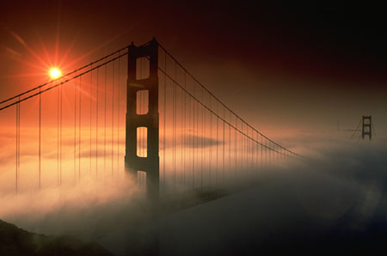

Introduction to Poetry Terms
Lines & Stanza
Meter
Rhyme
Rhyme Scheme
Repetition
Figurative
Language
Simile
Metaphor
Extended
Metaphor
Personification
Assonance
Consonance
Alliteration
Imagery
Allusion
Allegory
Hyperbole
Oxymoron
Diction
Tone

Slide 10
Lines and Stanzas
The basic unit of poetry is the line. It serves the same function as the sentence in prose, although most poetry maintains the use of grammar within the structure of the poem.
Most poems have a structure in which each line contains a set amount of syllables; this is called meter.
Lines are also often grouped into stanzas. The stanza in poetry is equivalent or equal to the paragraph in prose. Often the lines in a stanza will have a specific rhyme scheme.

Slide 11
Meter
Meter is the measured arrangement of words in poetry, the rhythmic pattern of a stanza, determined by the kind and number of lines. Meter is an organized way to arrange stressed/accented syllables and unstressed/unaccented syllables.
Whose woods / these are / I think /I know

Slide 12
Rhyme
Rhyme is when the endings of the words sound the same.
Dust of Snow
by Robert Frost
The way a crow
Shook down on me
The dust of snow
From a hemlock tree
Has given my heart
A change of mood
And save some part
Of a day I had rued.

Slide 13
INTERNAL RHYME
Internal Rhyme – rhyme within a line
Time, Slime, Mime
Internal Rhyme – Scornfully scaly snake which held his very fate
While I nodded nearly napping, suddenly their came a tapping

Slide 14
Rhyme Scheme
Rhyme scheme is the pattern of rhyming words at the end of each line. Not all poetry has a rhyme scheme. They are not hard to identify, but you must look carefully at which words rhyme and which do not.
Dust of Snow
by Robert Frost
The way a crow
Shook down on me
The dust of snow
From a hemlock tree
Has given my heart
A change of mood
And save some part
Of a day I had rued.
Poems of more than one stanza often repeat the same rhyme scheme in each stanza.
A
B
A
B
C
D
C
D

Slide 15
COUPLET
A rhymed pair of lines.
EXAMPLE:
From what I’ve tasted of desire
I hold with those who favor fire.
–Robert Frost, “Fire and Ice”

Slide 16
Repetition
Repetition is the repeating of a sound, word, or phrase for emphasis.
Conveys a feeling of anticipation
Inside
Inside the house
(I get ready)
Inside the car
(I go to school)
Inside the school
(I wait for the bell to ring)

Slide 17
Figurative Language
Whenever you describe something by comparing it with something else, you are using figurative language.
Figurative language is any language that goes beyond the literal meaning of words in order to furnish new effects or fresh insights into an idea or a subject. The most common figures of speech are simile, metaphor, and alliteration. Figurative language is used in poetry to compare two things that are usually not thought of as being alike.

Slide 18
SIMILE
A comparison using like or as.
EXAMPLES: As brave as a lion, As dumb as an ox

Slide 19
METAPHOR
A figure of speech in which one thing is spoken as though it were something else, a direct comparison of two unlike things.
Clouds are cotton candy.
Grandpa was a mule.
Tom is a rock.
They are fluffy.
They are stubborn.
They are hard.

Slide 20
EXTENDED METAPHOR
A figure of speech that compares two essentially unlike things at some length and in several ways.
EXAMPLE:
“All the world’s a stage, And all the men and women merely players.”
--William Shakespeare, As You Like It

Slide 21
PERSONIFICATION
Figurative language in which a nonhuman subject is given human characteristics
EXAMPLE:
The wind gently called her name

Slide 22
CONSONANCE
Repetition of internal or ending consonant sounds of words close together in poetry.
He clasps the crag with crooked hands;
Close to the sun in lonely lands;
Ringed with the azure world he stands.
- “The Eagle” by Lord Alfred Tennyson

Slide 23
ASSONANCE
The repetition of the vowel sounds followed by different consonants in two or more stressed syllables.
EXAMPLES:
“Men sell the wedding bells.”
“Strips of tinfoil winking like people”

Slide 24
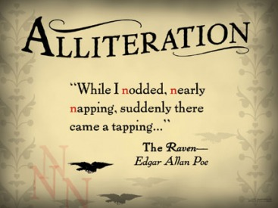
ALLITERATION
Repetition of the same, initial consonant sounds
EXAMPLES: Soft Sighing of the Sea

Slide 25
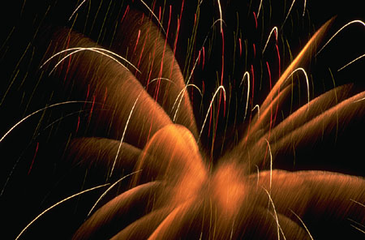
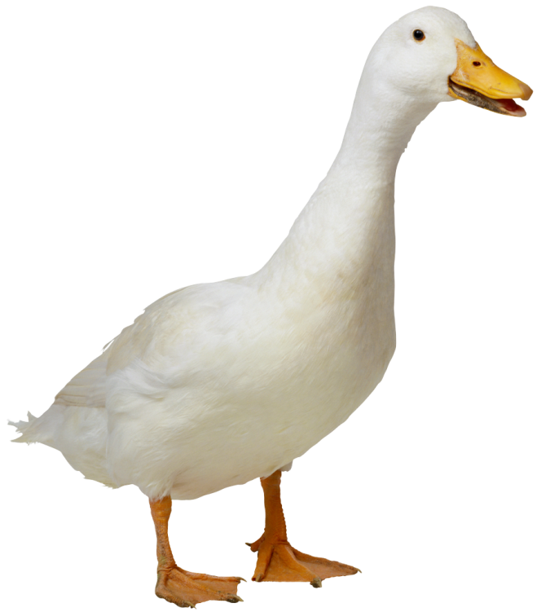
ONOMATOPOEIA
The use of words that imitate sounds.
Bang, Buzz, Thud, Hiss, Woof, Quack

Slide 26
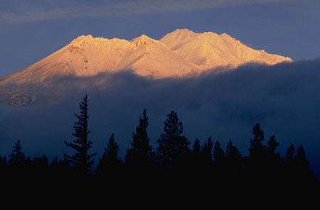
IMAGERY
Usually these words or phrases create a picture in the reader’s mind. Some imagery appeals to the other FIVE senses (sight, hearing, touch, taste, smell).
EXAMPLES:
  Sight – smoke mysteriously puffed our from his ears
  Sound – he could hear a faint but distant thump
  Touch – the burlap wall covering scraped his skin
  Taste – a salty tear ran down his cheek
  Smell – the scent of cinnamon floated into his nostrils

Slide 27
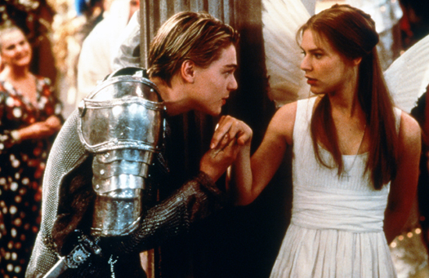
ALLUSION
An indirect reference to a famous person, place, event, or literary work.
EXAMPLE:
See the lights, See the party, the ball gowns, I see you make your way through the crowd. And say hello, little did I know . . . –Taylor Swift, Love Story

Slide 28
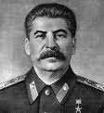


ALLEGORY
A work with two levels of meaning—a literal one and a symbolic one.
  Animal Farm
Symbolically, it is about the Russian Revolution and Stalin’s rule.
Literally about animals who overtake their farm and run it themselves.

Slide 29
HYPERBOLE
A bold, deliberate overstatement not intended to be taken seriously. The purpose is to emphasize the truth of the statement.
He weighs a ton.
I could eat a horse.

Slide 30
OXYMORON
The junction of words which, at first view, seem to be contradictory, but surprisingly this contradictions expresses a truth or dramatic effect.
EXAMPLES:
Pretty ugly
Icy hot

Slide 31
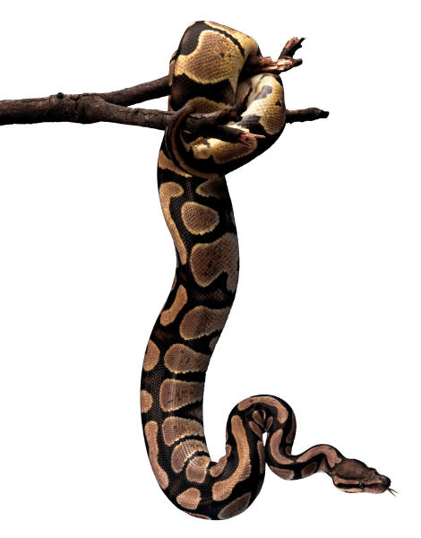
DICTION
A writer’s or speaker’s choice of words and way of arranging the words in sentences.
A few words on diction. . .
Connotation Denotation
Snake
any of numerous scaly, legless, sometimes venomous reptiles; having a long, tapering, cylindrical body and found in most tropical and temperate regions
evil or danger

Slide 32
Tone
The author’s attitude about a subject
  This is implied throughout the work
"I shall be telling this with a sigh/
Somewhere ages and ages hence:/
Two roads diverged in a wood, and I,
/I took the one less traveled by,/
And that has made all the difference."
-From “The Road Not Taken” By Robert Frost
~In this example, Frost is commonly interpreted as looking back on his experience with joy. That is true, if he were to speak those lines cheerfully. However, imagine that he actually sighs when he says "sigh" and he appears sullen when he says "And that has made all the difference." The entire meaning of the poem is changed, and Frost is, indeed, not thrilled with the choice he made in the past.

